Slide 1
Working with data
Smart application design

Slide 2
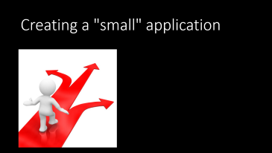
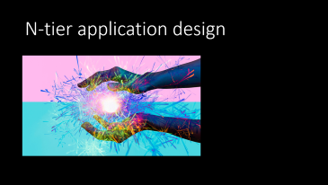
What's coming…

Slide 3

N-tier application design

Slide 4
Separating areas of concern
Applications deal with…
User input and output
Business rules & logic
Data acquisition and persistence
These are all separate areas of concern

Slide 5
Mushing concerns together leads to…
Complex classes
Code that is hard to maintain
Buggy code
Violates the Single-Responsibility Principle (SRP)

Slide 6
Single-responsibility principle (SRP)
Part of the 5 SOLID principles of OOP
Each module, package, class and method is responsible for a single aspect of application functionality
Example:
Method: creates a connection to a database
Class: obtains and pools connections
Package: contains classes that manage database input/output

Slide 7
In Java, there are two ways to separate concerns
Ultra-large applications may separate the different concerns into libraries
Smaller applications may use packages to separate the concerns
What are the concerns?
User input and output
Business rules
Data acquisition and persistence

Slide 8
What's a package?
A package is a way of organizing your Java source code into different directories
If all your source is in one file, packages may not make sense
If you have 30 files, packages make sense:
The compiler can handle the complexity
People cannot

Slide 9
Problems with school applications
They're small
Everything in one file
No packages

Slide 10
Why is this a problem?
In the industry, even small projects are big
A "small" microservice may contain 30-40 source files plus numerous resources
If you get a job as a Java developer you'll need to know about packages – deal with it!

Slide 11

Creating a "small" application
Notes:
How to create a "small" application

Slide 12


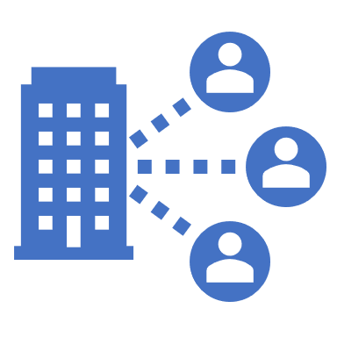

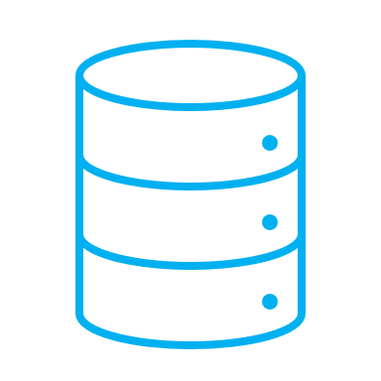
Designing with layers
Interacts
with User
Input/Output Layer
Applies Business Rules
Service Layer
Read/Write Tables
Data "DAO" Layer

Slide 13

Packaging the layers
Input/Output Layer
"main" package
(recipes)
"service" package
(recipes.service)
Service Layer
"entities" package
(recipes.entity)
"dao" package (recipes.dao)
Data "DAO" Layer

Slide 14
Watch the project grow!
Create the packages:
Main package (recipes)
Service package (recipes.service)
DAO package (recipes.dao)
Entity package (recipes.entity)

